Slide 1
Fun with Linux Lab

Slide 2
Fun with Linux Lab
Materials needed
Linux Virtual Machine
APT package manager
Note: This lab is meant to be fun and not aligned to any objectives, but rather a unique/fun way to learn some Linux commands and tricks

Slide 3
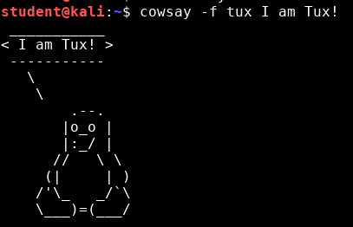
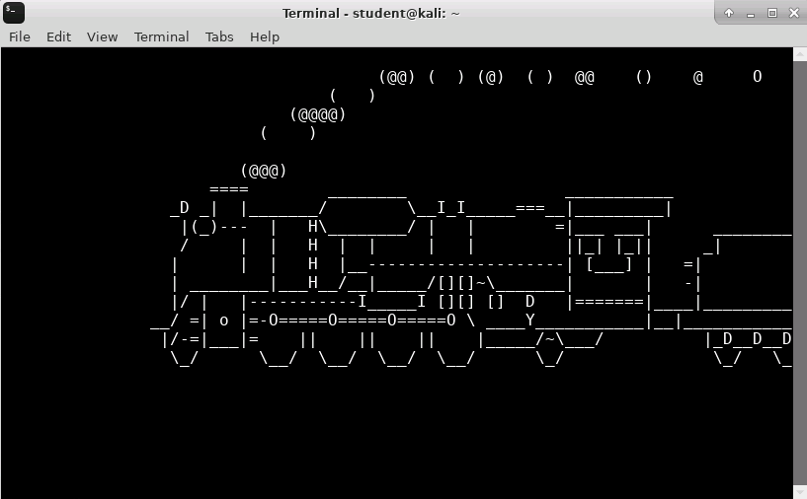
The Fun with Linux Lab
APT repository
cowsay, fortune, and lolcat
The Number Pi
What if you misspell “ls”?
Cat and Mouse
Take the Red or Blue Pill?
Are You Cold?
New Identity?
Aquarium? Yes Please!

Slide 4
APT Repository
First thing you need to do is make sure your APT repository is up to date, run the following command:
sudo apt-get update
This is the simple command to update the APT repository

Slide 5
APT Repository
The APT (Advanced Package Tool) is a tool to gain access to software repositories for certain Linux distros.
Search a repository with the following command:
sudo apt-cache search <what_to_search>
Install a program from the repository with the following command:
sudo apt-get install <program_name>

Slide 6
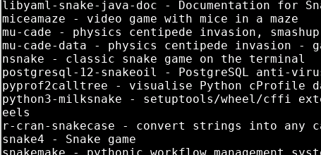
APT Repository
Search for the computer game snake
sudo apt-cache search snake
Find the game nsnake
Notice that nsnake is a classic snake game on the terminal
Install nsnake
sudo apt-get install nsnake

Slide 7
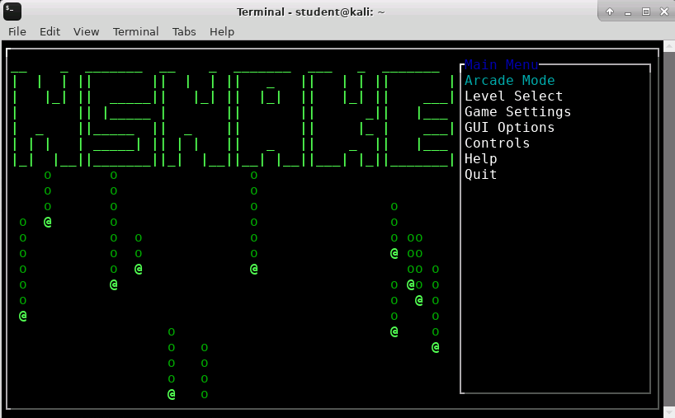

APT Repository
Once nsnake is installed, play nsnake with the following command:
nsnake
Once done, use the following command to remove nsnake from the system:
sudo apt-get remove nsnake
If you ever see a message like this, it’s just asking if you’re ok with making changes to the disk. You can just type “y” and hit ENTER to say yes.

Slide 8
cowsay, fortune, and lolcat
Install cowsay
sudo apt-get install cowsay
Install fortune
sudo apt-get install fortune
Install lolcat
sudo apt-get install lolcat

Slide 9
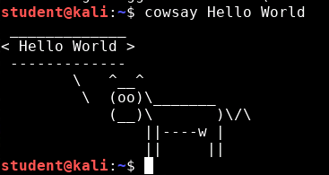
cowsay, fortune, and lolcat
Use cowsay with the following command:
cowsay Hello World
What else can you get the cow to say?

Slide 10
cowsay, fortune, and lolcat
Make the cow into the Linux mascot Tux!:
cowsay -f tux I am Tux!

Slide 11
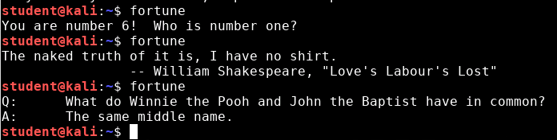
cowsay, fortune, and lolcat
Try out the fortune command:
fortune

Slide 12
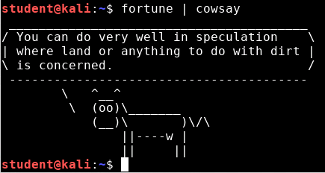
cowsay, fortune, and lolcat
Now make the cow say your fortune using the pipe (|) command:
fortune | cowsay
The pipe command allows two or more commands to be used where the output of the first command is used as the input for the next command

Slide 13
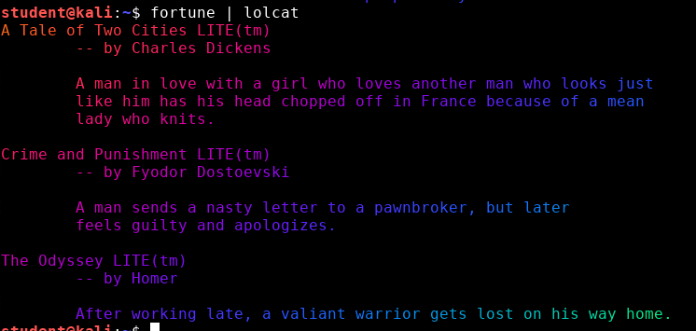
cowsay, fortune, and lolcat
Try to use the lolcat command:
fortune | lolcat

Slide 14
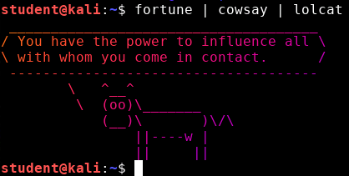
cowsay, fortune, and lolcat
Have a cow say a fortune while using the lolcat
fortune | cowsay | lolcat

Slide 15
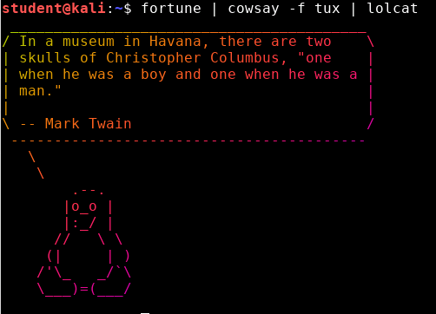
cowsay, fortune, and lolcat
What about tux?!:
fortune | cowsay -f tux | lolcat

Slide 16
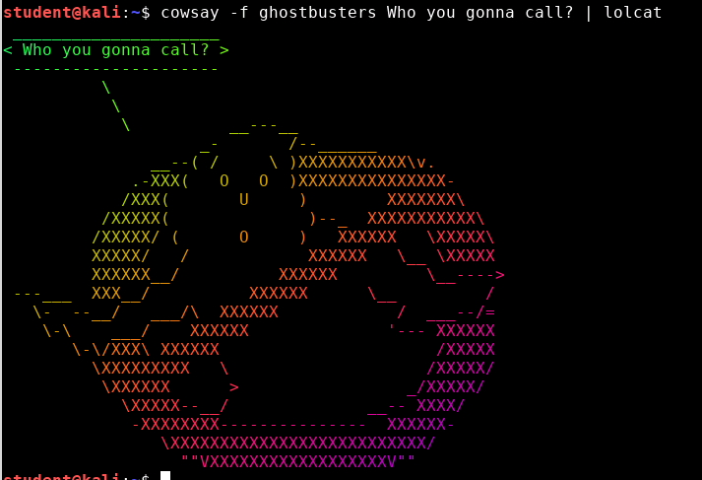
cowsay, fortune, and lolcat
What about the Ghostbusters?:
cowsay -f ghostbusters Who you gonna call? | lolcat

Slide 17
What if you misspell “ls”?
The command ls is used so often, and is typed in so quickly that it is misspelled as sl. Install the sl command:
sudo apt-get install sl
After it’s installed, use the sl command:
sl

Slide 18
What if you misspell “ls”?
You should have seen a train go across the screen

Slide 19
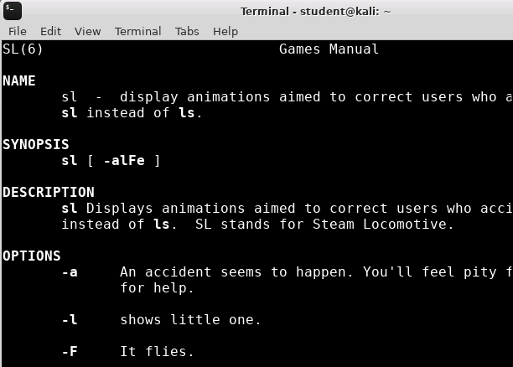
What if you misspell “ls”?
Almost every command has a manual in Linux, the manual can be found by typing “man” followed by the command
Let’s look at the manual for sl:
man sl
What do the following flags do?
-a
-l
-F
Type “q” to leave the terminal

Slide 20
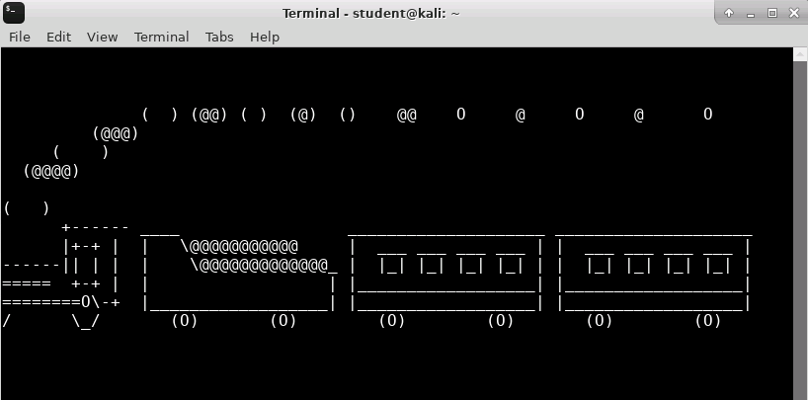
What if you misspell “ls”?
Use those flags:
sl -a
sl -l
sl -F
Flags/options “-” is the Terminal’s way to give arguments for commands

Slide 21
Cat and Mouse
Want to play cat and mouse?
Run the following commands to install oneko
sudo apt-get install oneko
oneko <-- Runs the program
What happens?

Slide 22
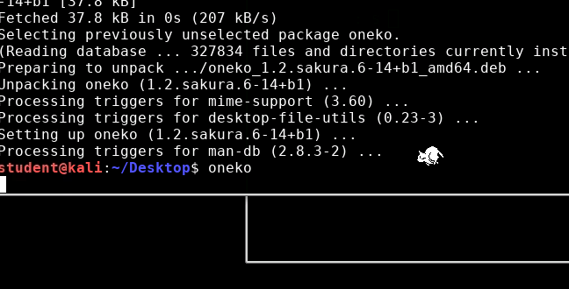
Cat and Mouse
You should see a cat chasing your mouse around on the screen
Open a new Terminal to leave oneko running
Notice that the cursor goes to the next line, this Terminal is controlling the cat (this controlling this “process” in the foreground

Slide 23
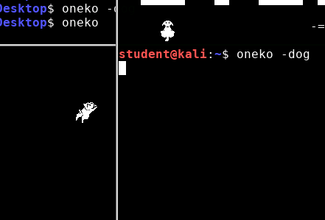
Cat and Mouse
Leave oneko running and open a new Terminal
Let a dog chase the mouse as well
oneko -dog
A cat and dog

Slide 24

Cat and Mouse
Press CTRL + C in the Terminal controlling the dog process to stop the dog
CTRL+C is the kill command and stops/kills a process running in the Terminal

Slide 25
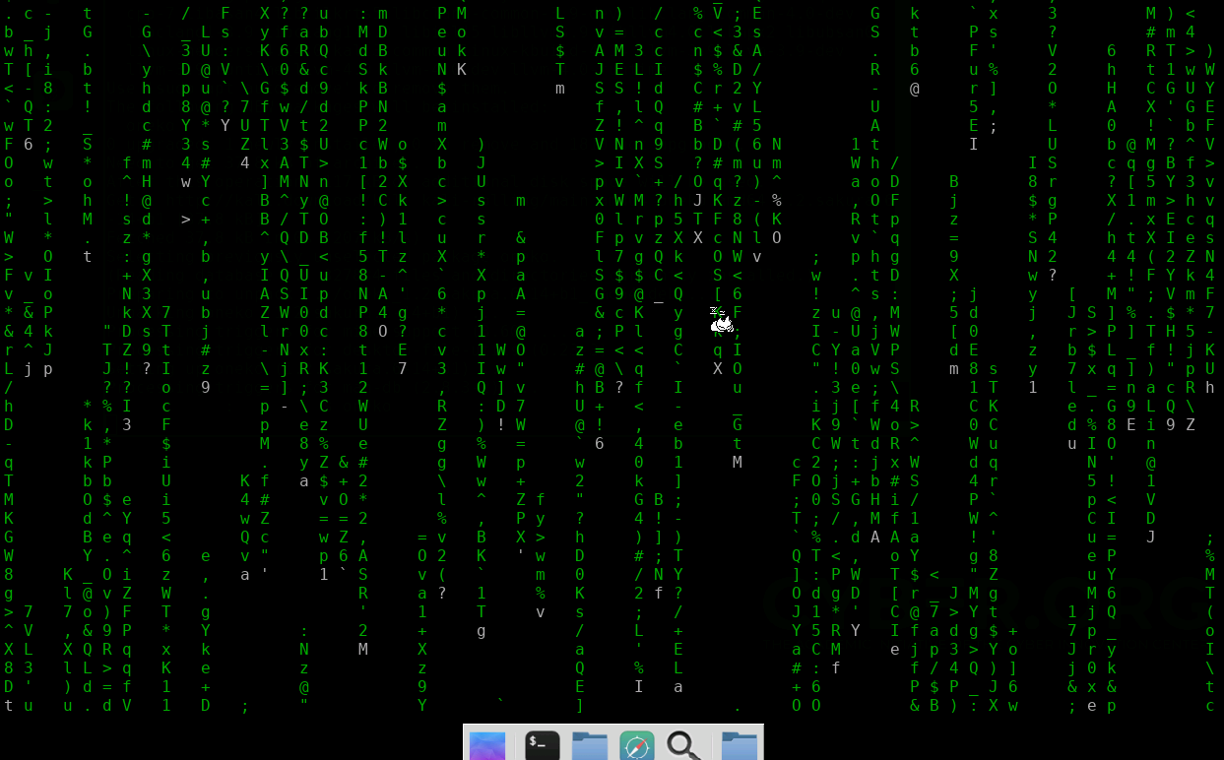
Take the Red or Blue Pill?
Want to turn your computer into the Matrix?
sudo apt-get install cmatrix
cmatrix <---Runs the program
Looks even better in full screen!
CTRL+C will stop cmatrix

Slide 26
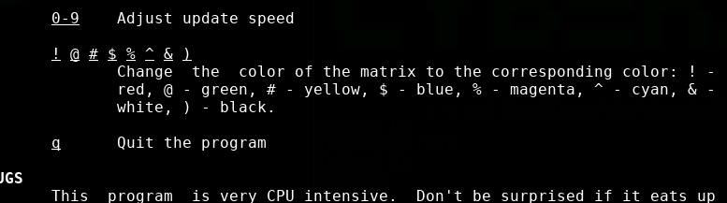
Take the Red or Blue Pill?
Open the manual for cmatrix
What does the manual say will happen if you press the “$” while the cmatrix command is running?
This line tells what the $ being pressed will change in the cmatrix program

Slide 27
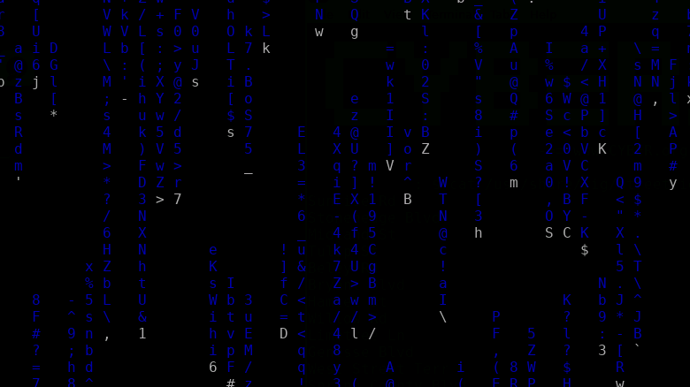
Take the Red or Blue Pill?
Run the cmatrix program and then press the $.
cmatrix
$
You should notice the Matrix turn from green to blue!

Slide 28
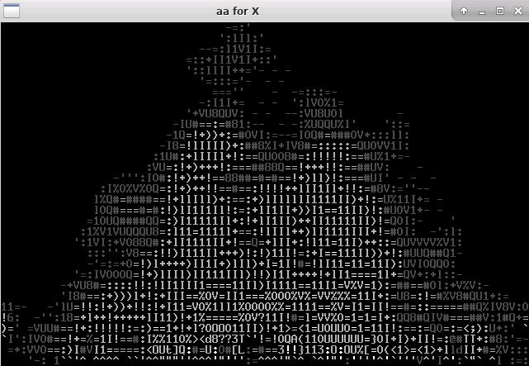
Are You Cold?
Then start a fire
sudo apt-get install libaa-bin
aafire <---starts the fire

Slide 29
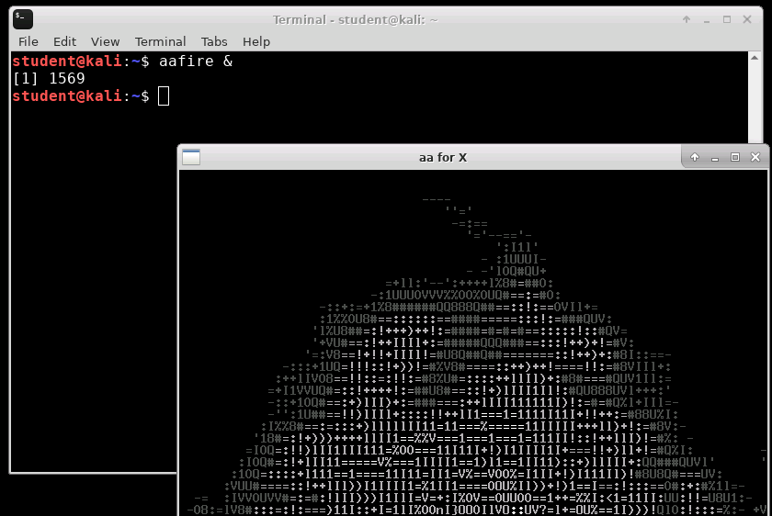
Are You Cold?
Press “q” to exit the fire
Restart the fire but use the “&” after the command:
aafire &
Notice the “aafire” job is backgrounded and you are able to type another command. The “&” pushes a command/process to the background.

Slide 30
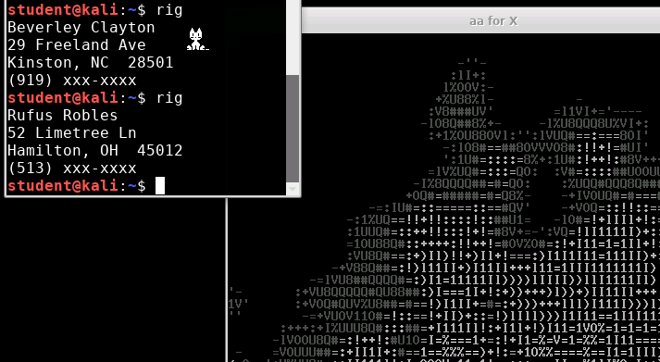
New Identity?
sudo apt-get install rig
rig <----Creates a new identity
Cozy fire
Cat
New Identities

Slide 31
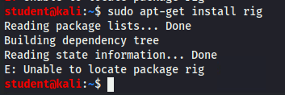
New Identity?
What happens if rig can’t be found?
This happened because Offensive Security updated the Kali APT repository and took out rig
The following slide explains how to work around this

Slide 32
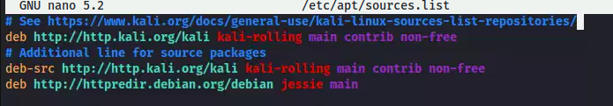
New Identity?
Please Note: Only use this slide if the APT repository was not able to locate the rig application
If rig did not install:
Open the APT sources list
sudo nano /etc/apt/sources.list
Add the following line
deb http://httpredir.debian.org/debian jessie main
Save and exit the nano editor (CTRL+X, y, ENTER)
Update the repository and install rig
sudo apt-get update
sudo apt-get install rig
Kali’s repositories
Debian 8’s repository

Slide 33
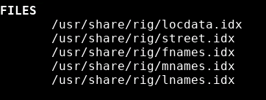
New Identity?
Where does the rig command get these “identities” from?
Open the rig manual
man rig
Look for FILES section
The file that the rig command pulls street names from

Slide 34
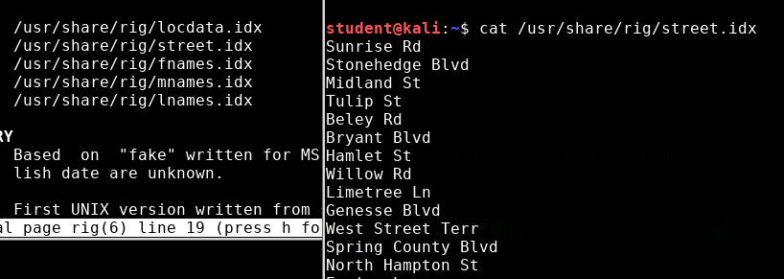
New Identity?
Use the concatenate command to display the contents of the street names file:
cat <path_to_file>/street.idx
The cat command displays the text of a file into the Terminal
List of street names the rig command pulls from

Slide 35
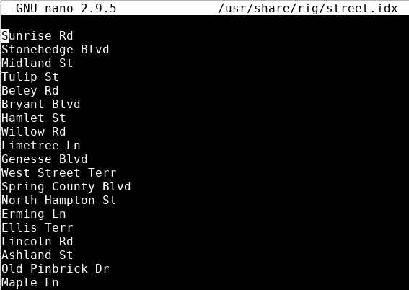
New Identity?
Want to add streets to rig? Open the nano editor to add streets:
sudo nano <path_to_file>/street.idx
The nano editor

Slide 36
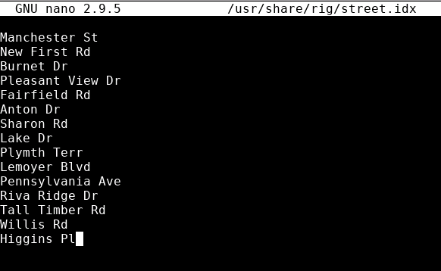
New Identity?
Add street names!
To Exit the nano editor
Press CTRL+x to exit
Press “y” for yes that you want to save
Hit ENTER to confirm the file name
Added street names
Use the rig command until you see one of your new streets!

Slide 37
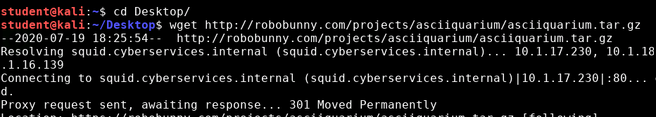
Aquarium? Yes Please!
Open a new Terminal
Navigate to the Desktop
cd Desktop
Download the asciiaquarium files
You should see the asciiquarium.tar.gz file on your Desktop
wget http://www.robobunny.com/projects/asciiquarium/asciiquarium.tar.gz
The wget command retrieves content from web servers

Slide 38
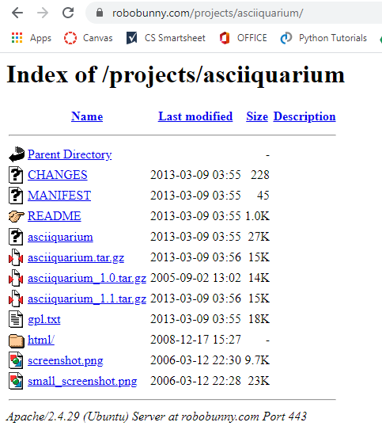
Aquarium? Yes Please!
This is the website for www.robobunny.com/projects/asciiquarium, the wget command goes to this website and pulls the asciiquarium.tar.gz file from this website
What is a tar.gz file? It is similar to a .zip file, it is a much larger file that is compressed down to a much smaller file

Slide 39
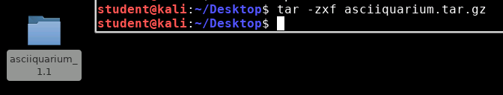
Aquarium? Yes Please!
Decompress the file using the following command:
tar -zxf asciiquarium.tar.gz
-x extracts the files
-f denotes the file
-z filters the .gz
You should see the asciiquarium_1.1 directory appear on your Desktop! This file has been decompressed/unzipped and brought to the Desktop

Slide 40

Aquarium? Yes Please!
Navigate into the asciiquarium_1.1 folder
cd asciiquarium_1.1
List out the files
ls
You should see the asciiquarium program as well as the README document!

Slide 41
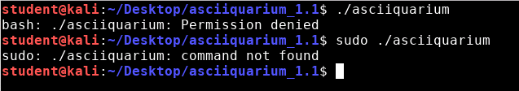
Aquarium? Yes Please!
The dot slash executes a program
Try to use the following command:
./asciiquarium or sudo ./asciiquarium
You should have received “command not found”
The asciiquarium program is not executable at this point

Slide 42
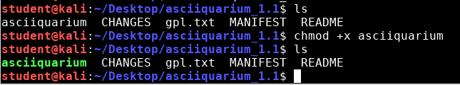
Aquarium? Yes Please!
Make the asciiquarium file executable
chmod +x asciiquarium
Use ls to check that it is now executable
ls
Notice the asciiquarium has changed colors. The “chmod +x” command makes asciiquarium an executable file

Slide 43
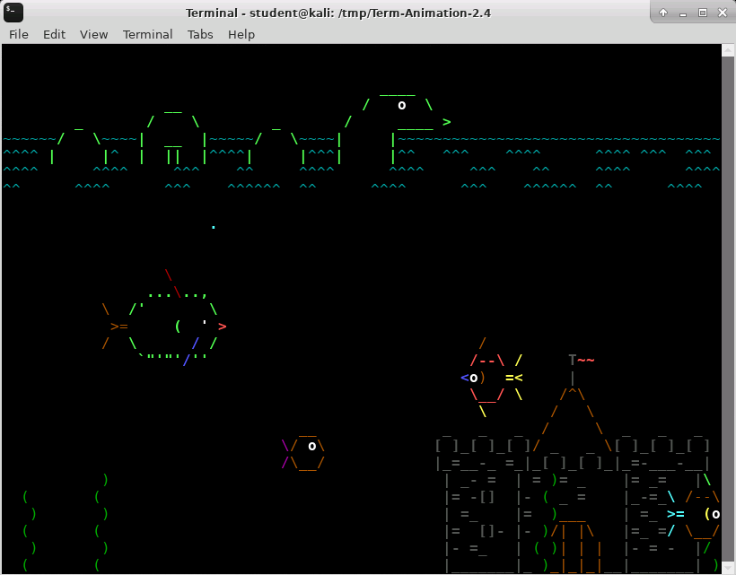
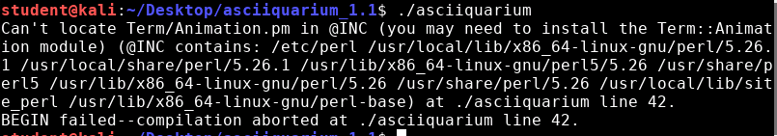
Aquarium? Yes Please!
Try to execute the asciiquarium
./asciiquarium
Chances are that you need to install Term::Animation, the next few slides will walk through installing Term::Animation
Working asciiquarium

Slide 44
Aquarium? Yes Please!
Use the following commands to install Term-Animation
sudo apt-get install libcurses-perl
cd /tmp
wget http://search.cpan.org/CPAN/authors/id/K/KB/KBAUCOM/Term-Animation-2.4.tar.gz
tar -zxf Term-Animation-2.4.tar.gz
cd Term-Animation-2.4/
perl Makefile.PL && make && make test
sudo make install
The “&&” command executes the next command if and only if the previous command succeeds.

Slide 45
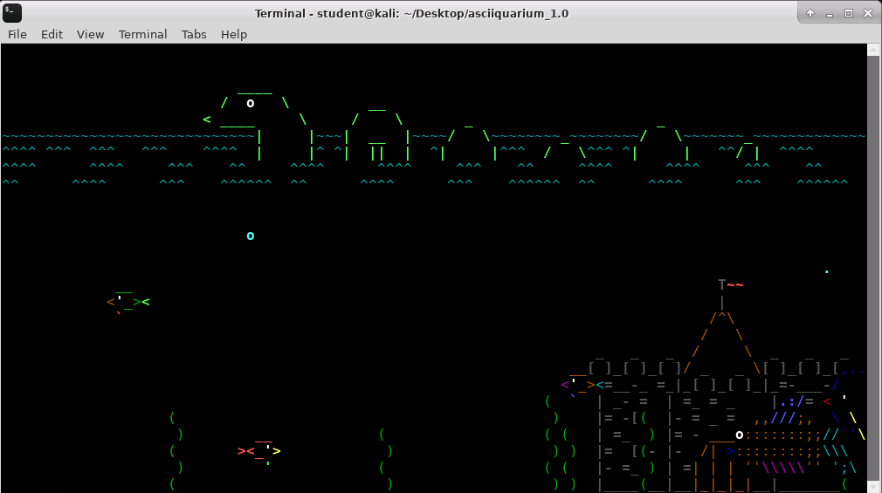
Aquarium? Yes Please!
Let’s try to run the aquarium again, navigate to the aquarium directory
cd <path_to_asciiquarium>
Execute the aquarium
./asciiquarium
Can press “q” or CTRL+C to exit the aquarium

